Slide 1



Object Oriented Programming
In JavaScript
Eyal Vardi
Microsoft MVP ASP.NET blog: eyalvardi.wordpress.com

Slide 2
Agenda
Object properties
Constructor (new)
Prototype
Inheritance

Slide 3
Object Properties

Slide 4
Data Properties
Data properties contain a single location for a data value.
Data properties have four attributes describing their behavior:
[[Configurable]]
[[Enumerable]]
[[Writable]]
[[Value]]

Slide 5
Data Properties
When a property is explicitly added to an object, [[Configurable]], [[Enumerable]], and [[Writable]] are all set to true while the [[Value]] attribute is set to the assigned value.
To change any of the default property attributes, you must use the ECMAScript 5 Object.defineProperty() method.
var person = { name: "Nicholas" };
var person = {};
Object.defineProperty( person, "name", { configurable: true,
enumerable: false, writable: false, value: "Michal"
});
alert(person.name); //Michal
person.name = "Eyal";
alert(person.name); //Michal

Slide 6
Configurable
var person = {};
Object.defineProperty(person, "name", {
configurable: false,
value: "Michal"
});
// Throws an error
Object.defineProperty(person, "name", {
configurable: true,
value: "Michal"
});

Slide 7
Accessor Properties
Accessor properties contain a combination of a getter function and a setter function.
Accessor properties have four attributes:
[[Configurable]]
[[Enumerable]]
[[Get]]
[[Set]]

Slide 8
Accessor Property Sample
var book = {
_year: 2004,
edition: 1
};
Object.defineProperty(book, "year", {
get: function(){
return this._year;
},
set: function(newValue){
if (newValue > 2004) {
this._year = newValue;
}
}
});
book.year = 2005;
__defineGetter__() and __defineSetter__() old version Prior to the ECMAScript 5.

Slide 9
Defining Multiple Properties
var book = {};
Object.defineProperties(book, {
// Data Properties
_year: { value: 2004 },
edition: { value: 1 },
// Accessor Properties
year: {
get: function () {
return this._year;
},
set: function (newValue) {
if (newValue > 2004) {
this._year = newValue;
this.edition += newValue - 2004;
}
}
}
});

Slide 10
Reading Property Attributes
The object.getOwnPropertyDescriptor() method can be used on any object in JavaScript, including DOM and BOM objects.
var descriptor = Object.getOwnPropertyDescriptor(book, "_year");
alert(descriptor.value); //2004
alert(descriptor.configurable); //false
alert(typeof descriptor.get); //”undefi ned”
var descriptor = Object.getOwnPropertyDescriptor(book, "year");
alert(descriptor.value); //undefined
alert(descriptor.enumerable); //false
alert(typeof descriptor.get); //”function”

Slide 11
Protecting objects
There are three levels of protection:
Preventing extensions is the weakest level
Impossible to add properties to object.
Sealing is stronger
+ Configurable: false
Freezing is strongest
+ Writable: false (read only)

Slide 12
Preventing extension
// makes it impossible to add properties to obj. Example:
var obj = { foo: 'a' };
Object.preventExtensions(obj);
obj.bar = 'b'; // fails silently
alert(obj.bar); // undefined
// You can still delete properties, though.
delete obj.foo;
alert(obj.foo); // undefined
// Checks whether obj is extensible:
Object.isExtensible(obj); // false

Slide 13
Sealing
prevents extensions and makes all properties “unconfigurable”. The latter means that the attributes of properties can’t be changed, any more.
var obj = { foo: 'a' };
Object.getOwnPropertyDescriptor(obj, 'foo'); // before sealing
// { value: 'a', writable: true, enumerable: true, configurable: true }
Object.seal(obj);
Object.getOwnPropertyDescriptor(obj, 'foo'); // after sealing
// { value: 'a', writable: true, enumerable: true, configurable: false }
// You can still change the property foo:
obj.foo = 'b';
Object.isSealed(obj); // true

Slide 14
Freezing
Makes all properties non-writable and seals.
var point = { x: 17, y: -5 };
Object.freeze(point);
point.x = 2; // no effect, point.x is read-only
//Checking whether an object is frozen
Object.isFrozen(obj); // true

Slide 15
Constructor (new)

Slide 16
The Constructor Pattern
function Person(name, age, job) {
this.name = name;
this.age = age;
this.job = job;
this.sayName = function () {
alert(this.name);
};
}
var person1 = new Person("Dan", 29, "Software Engineer");
var person2 = new Person("Greg", 27, "Doctor");

Slide 17
The Constructor Pattern
Calling a constructor causes the following:
Create a new object.
Assign the this value of the constructor to the new object.
Execute the code inside the constructor.
Assign to __proto__ property of the new object the function prototype.
Return the new object.
alert(person1.constructor == Person); //true
alert(person2.constructor == Person); //true

Slide 18
Constructors as Functions
Any function that is called with the new operator acts as a constructor, whereas any function called without it acts just as you would expect a normal function call to act.
//use as a constructor
var person = new Person("Dan", 29, "Engineer");
person.sayName(); // "DaN"
//call as a function
Person("Greg", 27, "Doctor"); //adds to window
window.sayName(); //"Greg"
//call in the scope of another object
var o = new Object();
Person.call(o, "Kristen", 25, "Nurse");
o.sayName(); //"Kristen"

Slide 19
Closure Pattern
Private members.
Methods are created once for each instance.
function Point(x, y)
{
var _x = x;
var _y = y;
this.getX = function(){ return _x; }
this.getY = function(){ return _y; }
}
var p = new Point(1, 2);

Slide 20
Problems with Constructors
The major downside to constructors is that methods are created once for each instance.
function Person(name, age, job) {
...
this.sayName = function () {
alert(this.name);
};
//logical equivalent
this.sayName = new Function("alert(this.name)");
}
alert(person1.sayName == person2.sayName); //false

Slide 21
Work Around This Limitation
function Person(name, age, job) {
this.name = name;
this.age = age;
this.job = job;
this.sayName = sayName;
}
function sayName() {
alert(this.name);
}

Slide 22
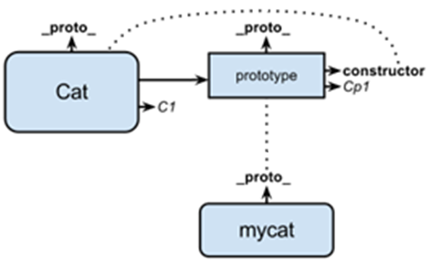
Combination Constructor & Prototype
function Cat(name, age, job){
this.name = name;
this.age = age;
this.friends = ['A', 'B'];
}
Cat.prototype.sayName = function () { return this.name; }
var myCat = new Cat('Mizi', 29);

Slide 23
Dynamic Nature of Prototypes
Changes made to the prototype at any point are immediately reflected on instances.
The [[Prototype]] pointer is assigned when the constructor is called.
var friend = new Person();
Person.prototype.sayHi = function(){
alert("hi");
};
friend.sayHi(); //"hi" - works!

Slide 24
Prototype Assignment
function Person(){ }
var friend = new Person(); // friend.__proto__ = Person.prototype
Person.prototype = {
constructor: Person,
name : "Nicholas",
age : 29,
job : "Software Engineer",
sayName : function () { alert(this.name); }
};
friend.sayName();
// Error

Slide 25
Dynamic Prototype Pattern
Maintaining the benefits of using both a constructor and a prototype by initializing the prototype inside the constructor.
function Person(name, age, job){
// properties
this.name = name;
this.age = age;
this.job = job;
// methods
if (typeof this.sayName != "function"){
Person.prototype.sayName = function(){
alert(this.name);
};
}
}
var friend = new Person('Nicholas', 29, 'Software Engineer');
friend.sayName();

Slide 26
Inheritance

Slide 27
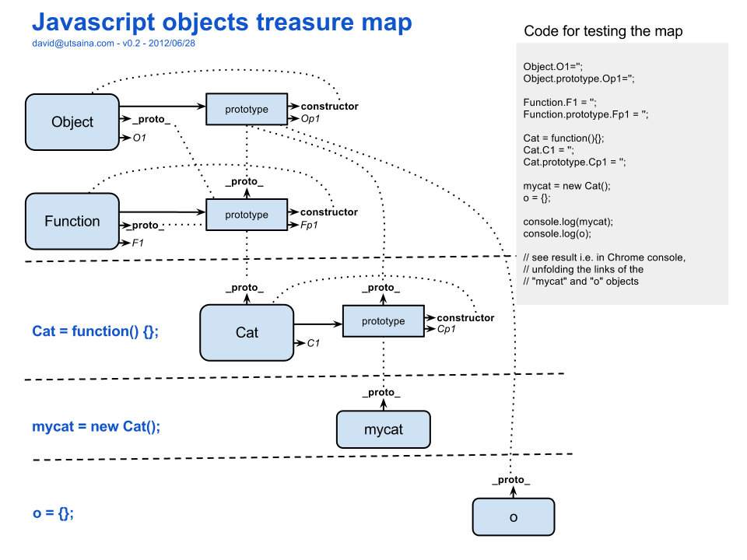

Slide 28
SubType.prototype = SuperType.prototype
function SuperType() { this.val = true; }
SuperType.prototype.getSuperValue = function () {
return this.val;
};
function SubType() { this.subVal = false; }
//inherit from SuperType
SubType.prototype = SuperType.prototype;
SubType.prototype.getSubValue = function () { return this.subVal; };
var instance = new SubType(); // undefined ( this.val == undefined )
alert(instance.getSuperValue() );
Fail

Slide 29
SubType.prototype = new SuperType();
function SuperType() { this.val = true; }
SuperType.prototype.getSuperValue = function () {
return this.val;
};
function SubType() { this.subVal = false; }
SubType.prototype = new SuperType();
SubType.prototype.getSubValue = function () { // new method
return this.subVal;
};
SubType.prototype.getSuperValue = function () {// override method
return false;
};
var instance = new SubType();
alert(instance.getSuperValue()); //false

Slide 30
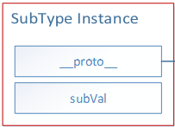
SubType.prototype = new SuperType();
Fail

Slide 31
Problems with Prototype Chaining
The major issue revolves around prototypes that contain reference values.
function SuperType(){
this.colors = ['red', 'blue', 'green'];
}
function SubType(){
}
SubType.prototype = new SuperType();
var instance1 = new SubType();
instance1.colors.push('black');
alert(instance1.colors);
var instance2 = new SubType();
alert(instance2.colors);
//"red,blue,green,black"
//"red,blue,green,black"

Slide 32
Constructor Stealing
Call the supertype constructor from within the subtype constructor.
function SuperType(){
this.colors = ['red', 'blue', 'green'];
}
function SubType(){
//inherit from SuperType
SuperType.call(this);
}
SubType.prototype = new SuperType();
var instance1 = new SubType();
instance1.colors.push("black");
alert(instance1.colors);
var instance2 = new SubType();
alert(instance2.colors);
//"red,blue,green,black"
//"red,blue,green"

Slide 33
Passing Arguments
One advantage that constructor stealing offers over prototype chaining is the ability to pass arguments into the supertype constructor from within the subtype constructor.
function SuperType(name){
this.name = name;
}
function SubType(){
//inherit from SuperType passing in an argument
SuperType.call(this, "Nicholas");
//instance property
this.age = 29;
}
SubType.prototype = new SuperType();
...
var instance = new SubType();
alert(instance.name); //"Nicholas";
alert(instance.age); //29

Slide 34
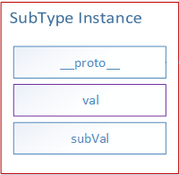
Constructor Stealing
Fail

Slide 35
Object Create
In 2006, Douglas Crockford wrote an article titled “Prototypal Inheritance in JavaScript”.
function create(o) {
function F() { }
F.prototype = o;
return new F();
}

Slide 36
Prototypal Inheritance
ECMAScript 5 formalized the concept of prototypal inheritance by adding the Object.create() method.
var person = {
name: "Eyal",
friends: ["Ran", "Dan"]
};
var anotherPerson = Object(person); // Object.create(person);
anotherPerson.name = "Greg";
anotherPerson.friends.push("Rob");
var yetAnotherPerson = Object(person);
yetAnotherPerson.name = "Linda";
yetAnotherPerson.friends.push("Van");
alert(person.friends); // "Ran, Dan, Rob, Van"

Slide 37
function SuperType(name){
this.name = name;
this.colors = ['red', 'blue', 'green'];
}
SuperType.prototype.sayName = function(){ alert(this.name); };
function SubType(name, age){
SuperType.call(this, name);
this.age = age;
}
SubType.prototype = Object.create(SuperType.prototype);
SubType.prototype.sayAge = function(){
alert(this.age);
};

Slide 39
Full Solution Inheritance
function SuperType(name){
this.name = name;
this.colors = ['red', 'blue', 'green'];
}
SuperType.prototype.sayName = function(){ return this.name; };
function SubType(name, age){
SuperType.call(this, name);
this.age = age;
}
SubType.prototype = Object.create(SuperType.prototype);
SubType.prototype.constructor = SubType;
SubType.prototype.sayAge = function(){
alert(this.age);
};
SubType.prototype.sayName = function(){
return SuperType.prototype.sayName.call(this) + "!!";
};
fix constructor
override

Slide 40
Instance of Operator
ECMAScript provides the instanceof operator.
The logic behind obj instanceof F:
Get obj.__proto__
Compare obj.__proto__ against F.prototype
If no match then set temporarily obj = obj.__proto__ and repeat step 2 until either match is found or the chain ends.
alert( person instanceof Object );
alert( colors instanceof Array );
alert( pattern instanceof RegExp );

Slide 41
Prototype & Instance Relationships
var instance = new SubType();
alert(instance instanceof Object); //true
alert(instance instanceof SuperType); //true
alert(instance instanceof SubType); //true
alert(Object.prototype.isPrototypeOf(instance)); //true
alert(SuperType.prototype.isPrototypeOf(instance)); //true
alert(SubType.prototype.isPrototypeOf(instance)); //true

Slide 42
toString() to Detect Object Class
[[class]] property is not accessible directly, but toString, returns it with a small wrapping.
var toString = Object.prototype.toString;
toString.call(new Date); // [object Date]
toString.call(new String); // [object String]
toString.call(Math); // [object Math]
toString.call(undefined); // [object Undefined]
toString.call(null); // [object Null]

Slide 43
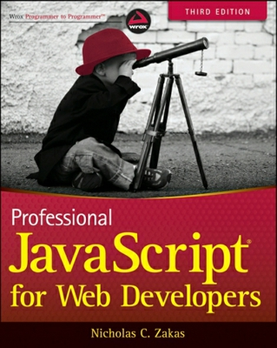
Resources
Professional JavaScript for Web Developers
Good links:
http://eyalvardi.wordpress.com/resources/html-5-course-resourses/javascript/
http://javascript.info/tutorial

Slide 44
Thanks
eyalvardi.wordpress.com
Eyal Vardi
Microsoft MVP ASP.NET blog: eyalvardi.wordpress.com

